Slide 1

Indira College of Engineering and Management (MCA) Parandwadi, Pune
Project Report on
“Food order system”
Submitted By –
Nainesh Gopalrao Iche – 23029
Department of MCA
2021-22

Slide 2
Introduction
Roll of the Internet and Technology
Making payment easier
Gives a verity of Food to the customer
Just go Online, Order and Enjoy the Food
Minimize the time and human errors

Slide 3
Existing System and Need of the System
No need to physically go to Restaurants or Hotels
Within a few minutes get your order without deal with the crowd
Management of customer’s Account and Data

Slide 4
Future Scope
Simplify managerial tasks as well as Improve the dining experienced
Healthy relationship with customers
Need of the customers will Improve

Slide 5
Modules
Admin Dashboard :
Login
Restaurant Management
Application Management
Order Management
Payments

Slide 6
Customer App :
Login / Sign Up (Social Medial)
Homepage
Menu
Cart Section
Sorting out System
Payment Method
Order Status and Tracking
Wish list
Place Order

Slide 7
Software Requirements
Windows 7, Windows 10.
Android Studio, Visual Studio Code.
Linux Kernel.
Firebase DB
Hardware Requirements:
PC, Laptop Configuration
Processor – i3 or any higher version
Hard Disk – 10 GB or more
RAM – 8GB RAM or more

Slide 8
Android ( Linux kernel ) Configuration
Android Version – Above Android 6.0 (Marshmallow)
Storage – 30 MB or more
RAM – 2GB RAM or more
Technologies Used :
Front-end Design :- [ Android Studio (JAVA) ], Android Studio Code.
Database :- [ Firebase ]

Slide 9
Proposed Of the System
Easy to use to the user
All the waiters or workers get more time to manage the other things
Availability of Tables
Reduce the workload of the waiters

Slide 10
Objectives of the System
Manage the details of the Items
The roll of the Administrator
Reduce the manual work
Track your order by your own

Slide 11
User Requirements
Quick search by dishes and restaurants
Order status
Convenient method of payment
First-line support
Promo code system

Slide 12
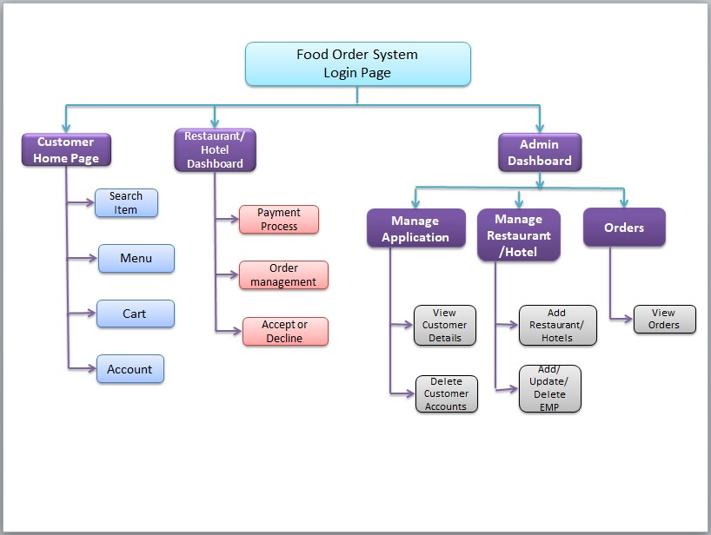
Module Hierarchy Diagram:

Slide 13
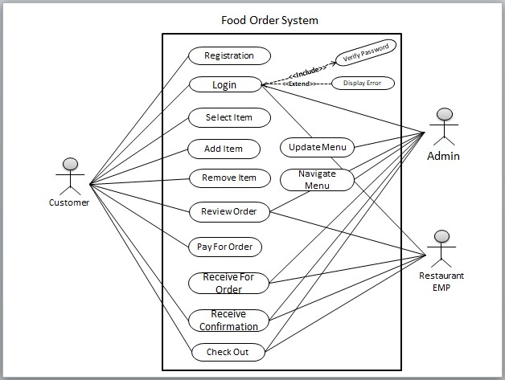
Use Case Diagram:

Slide 14
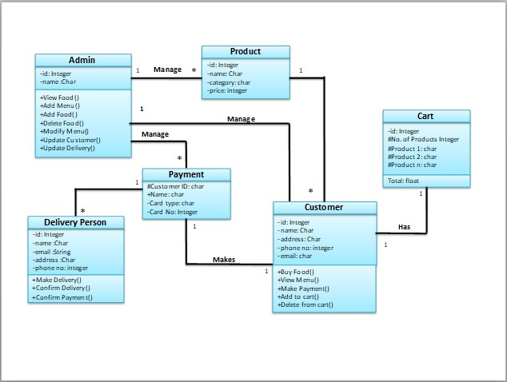
Class Diagram:

Slide 15
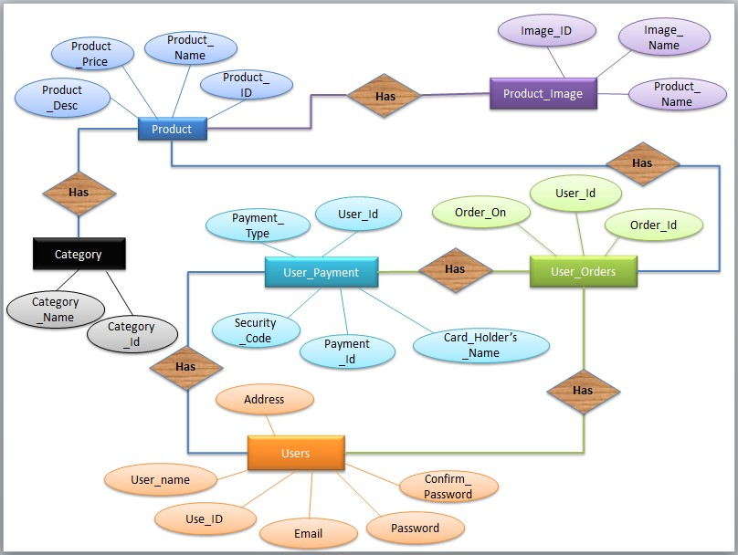
E-R Diagram:

Slide 16
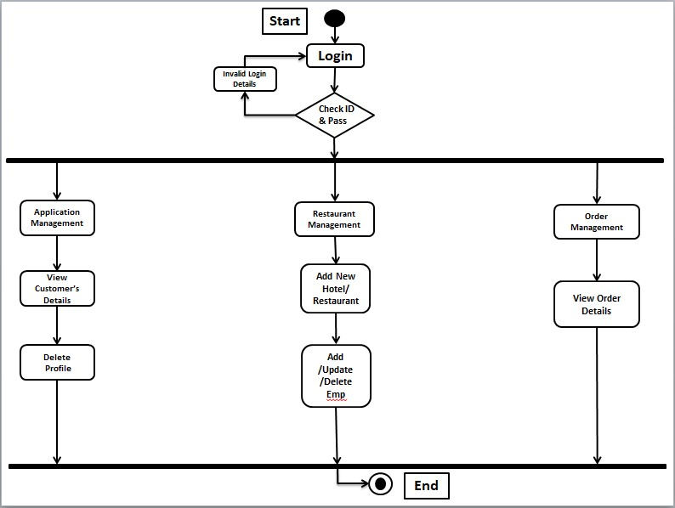
Activity Diagram (Admin):

Slide 17
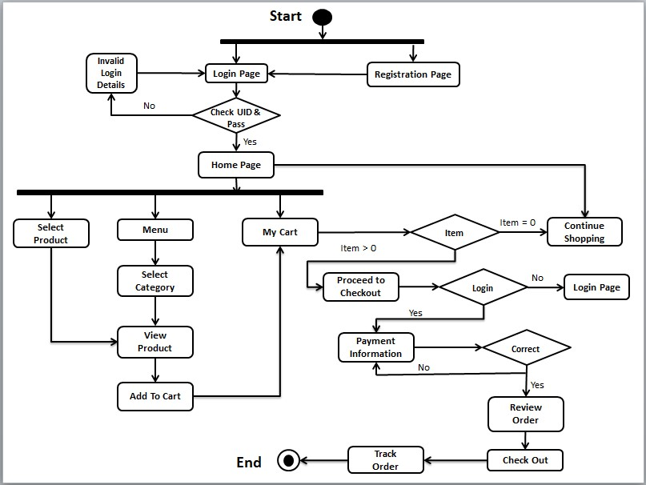
Activity Diagram (Customer):

Slide 18

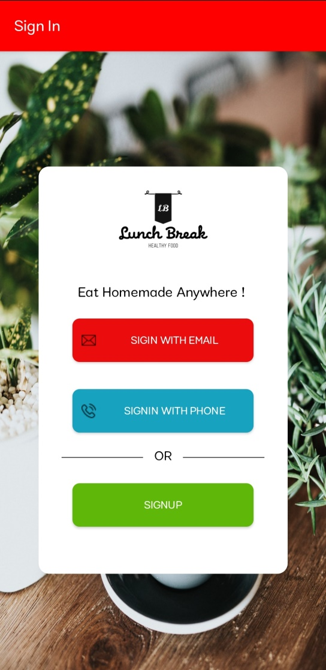
User Interface Design

Slide 19
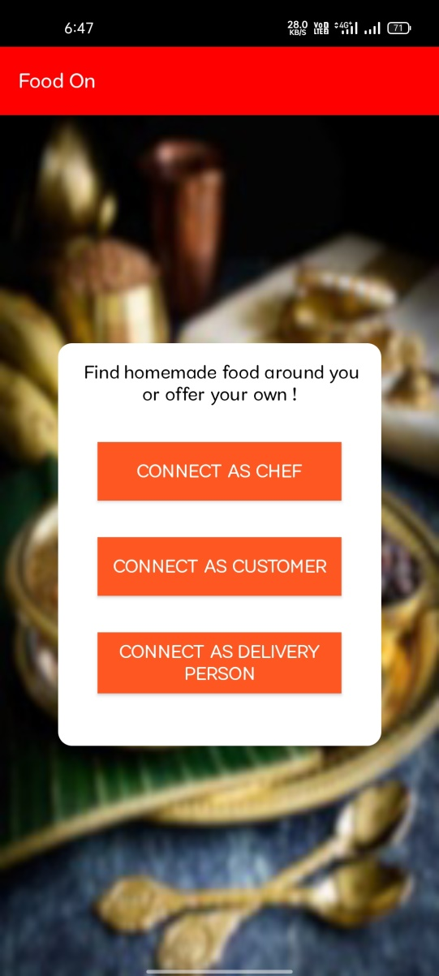
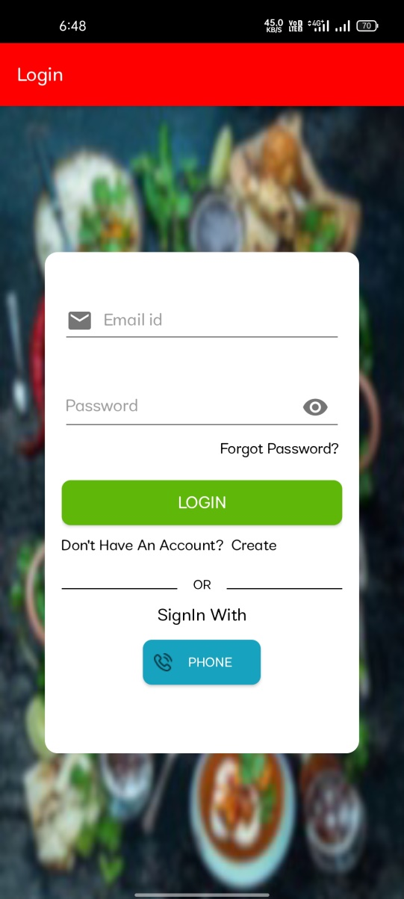

Slide 20
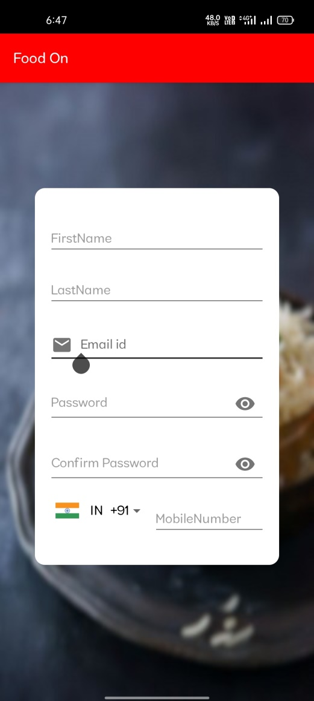
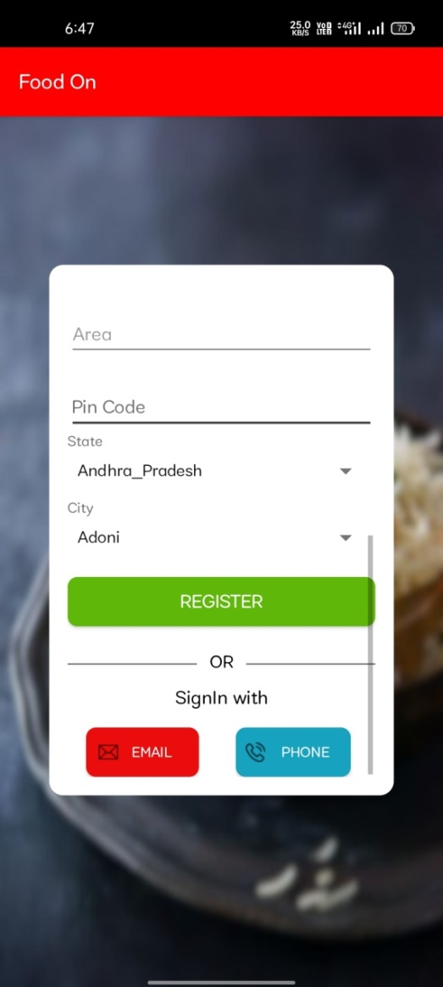

Slide 21
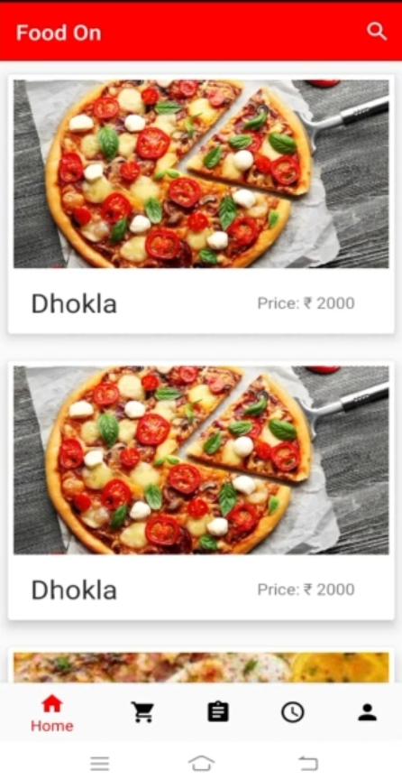
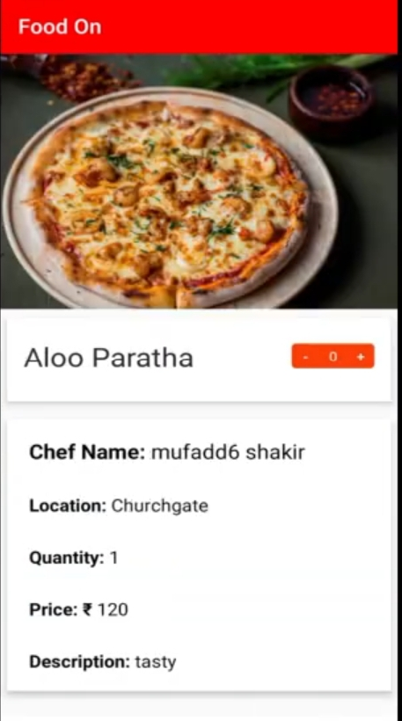

Slide 22
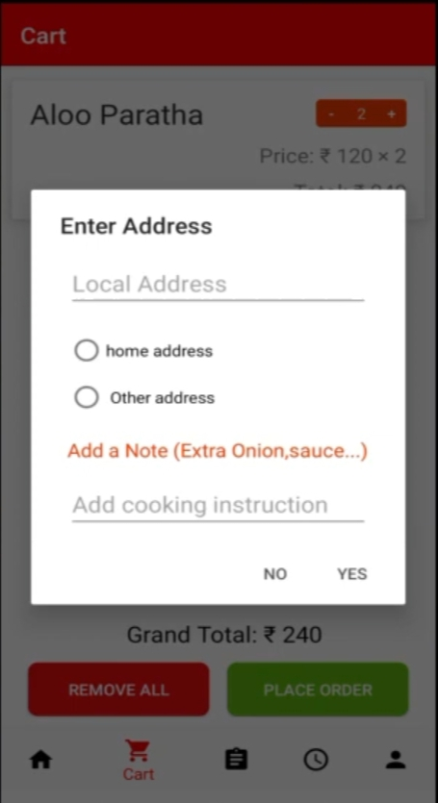
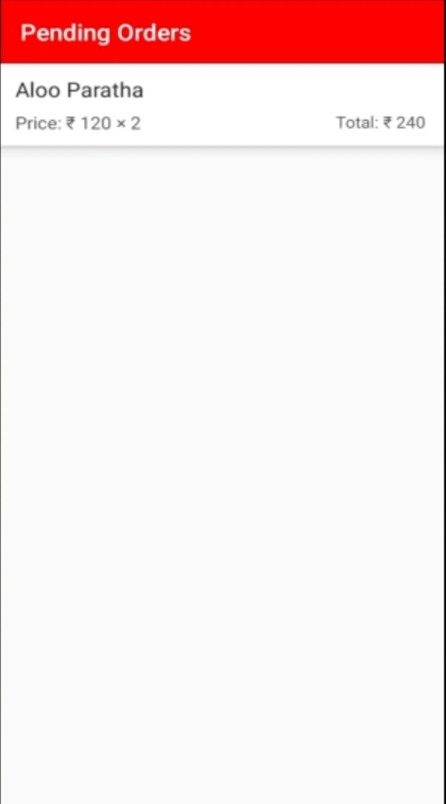

Slide 23
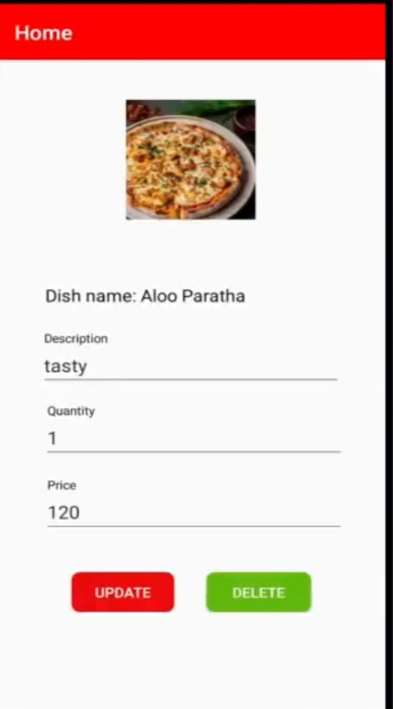
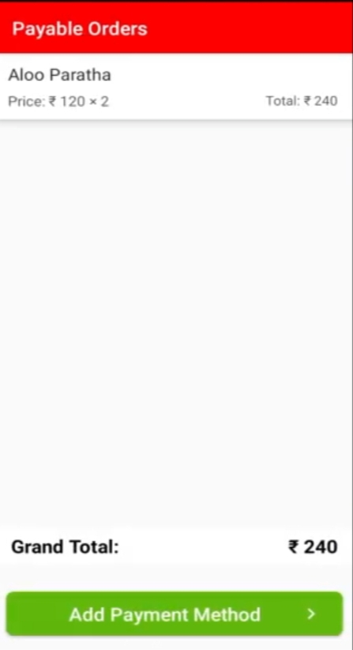

Slide 24
